Slide 1
Co25-01-1869/2020 Gathima Stephen mburu
Unlocking the Future A Deep Dive into Machine Learning and Deep Learning

Slide 2





Introduction to Machine Learning
In this presentation, we will explore the
of
and
. Understanding these
technologies is crucial as they are shaping
the future of delve into their
. We will
, challenges,
and potential to revolutionize various industries.

Slide 3
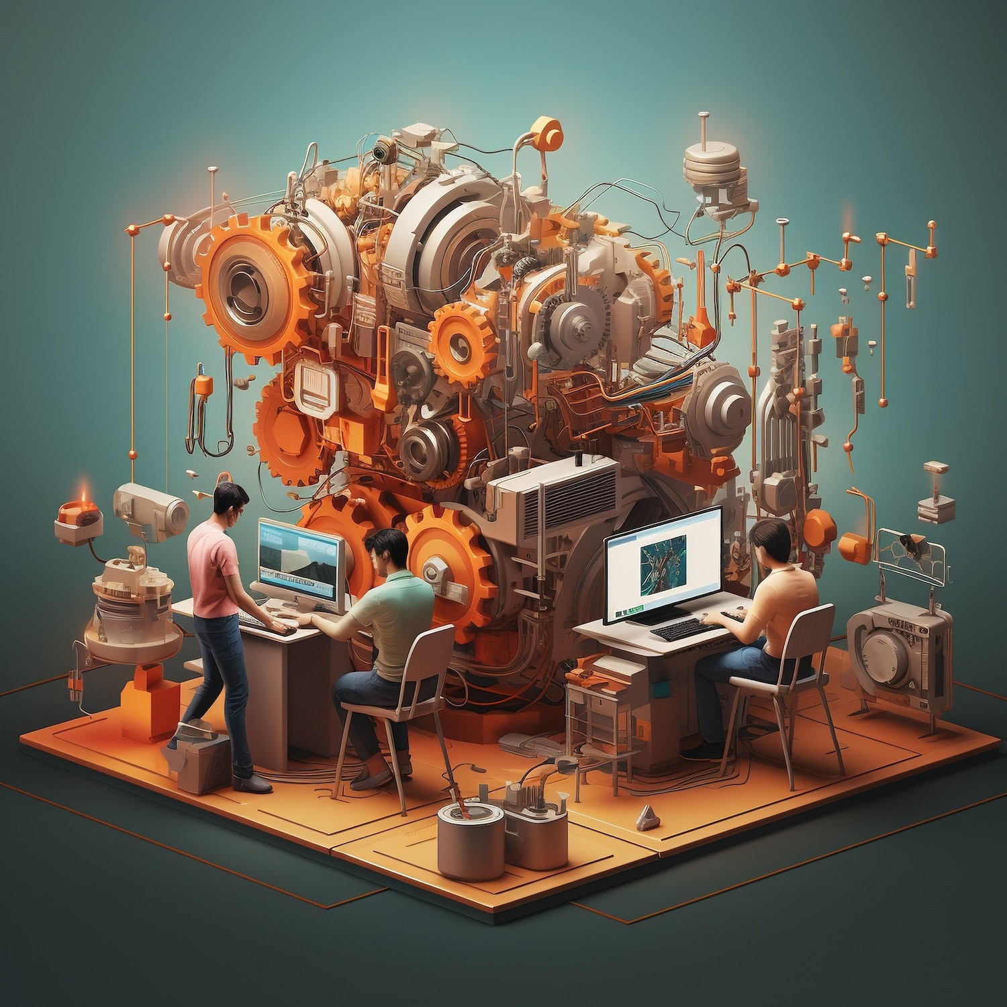



What is Machine Learning?
is a subset of
that enables systems to learn from data and improve over time without explicit programming. It involves algorithms that analyze patterns and make decisions based on data inputs, leading to smarter applications in various ﬁelds.

Slide 4
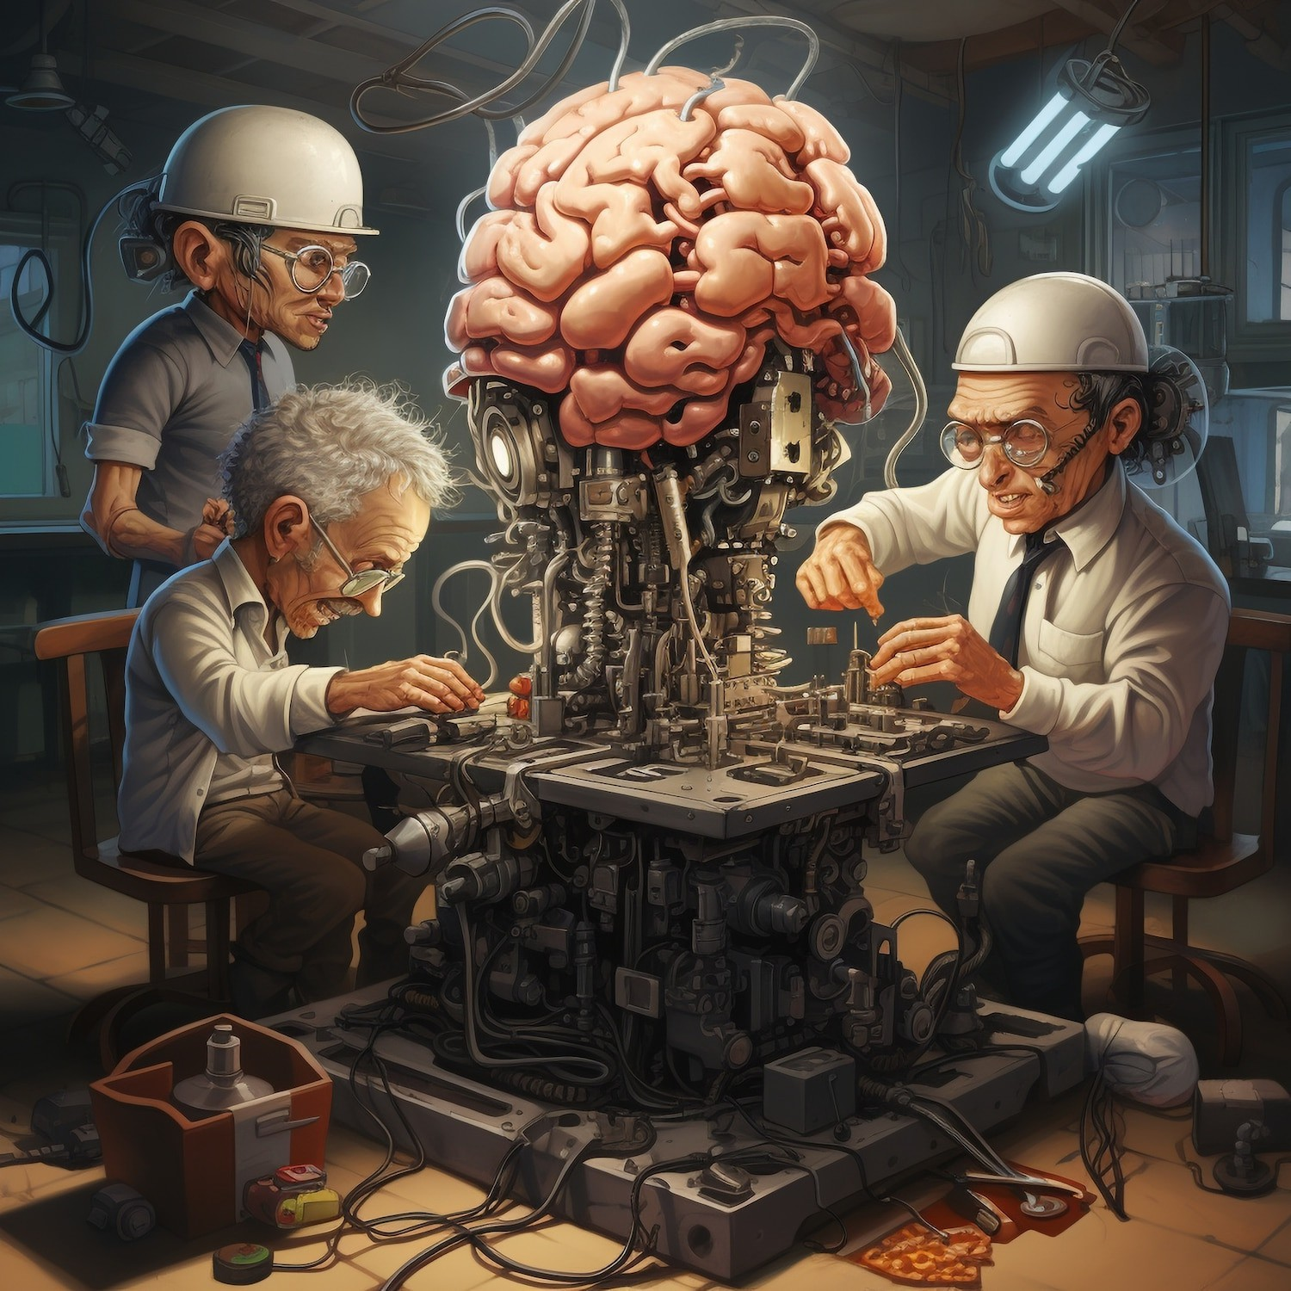




Types of Machine Learning
There are three main types of
: ,
, and
. Each type serves different purposes, from predicting outcomes based on labeled data to discovering hidden patterns in unlabeled data, enhancing decision-making processes.

Slide 5


Introduction to Deep Learning
is a specialized area of that uses
to analyze data. It mimics the human brain's structure and function,
enabling machines to learn from vast amounts of data, leading to breakthroughs
in image and speech recognition.

Slide 6



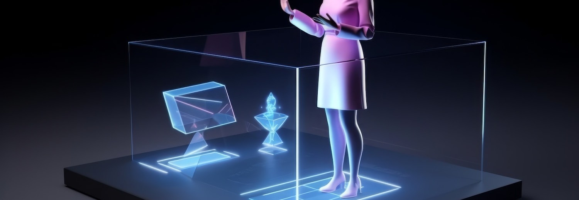
has numerous applications, including ,
, and . These technologies are transforming industries by enabling machines to perform complex tasks that were previously thought to be exclusive to humans.

Slide 7





Despite its potential, faces challenges such as ,
,
and the need for . Addressing these issues is essential to ensure the reliability and fairness of machine learning models in real-world applications.

Slide 8
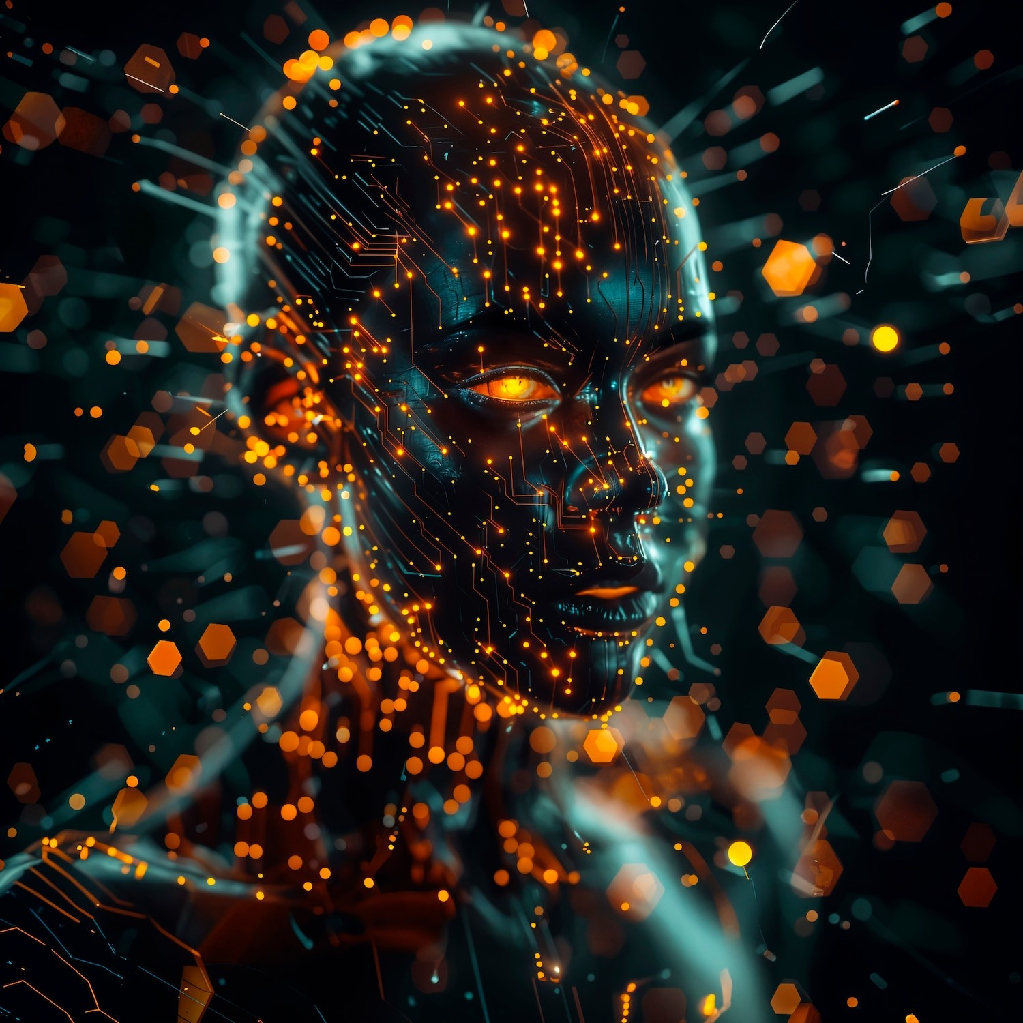




The Future of AI Technologies
The future of
looks promising, with advancements in
and
and
. As these technologies evolve, they will unlock new opportunities, drive innovation, and create more efﬁcient solutions across various sectors.

Slide 9





Conclusion
In conclusion, and
are pivotal in shaping the future of technology. By understanding their concepts, applications, and challenges, we can harness their potential to drive
and improve our lives in countless ways.

Slide 10
Thanks!

